Slide 1


Isabel Jellen
Robert Liu
Marina Moore
Derek Nguyen
Nicolas Parra
Notes:
everyone

Slide 2
System Description
Database:
Store information about flights, employees, customers.
Viewed through a GUI for both employees and customers.
Employee accounts
Registered to each employee at CAI
Allow employees to directly edit the database
All privileges given to customer accounts.
Customer accounts
View and purchase flights, check in, and view flight statuses
Notes:
Nick

Slide 3
Team Organization
Isabel Jellen: Controllers, documentation, some test cases
Robert Liu: Documentation, test cases
Marina Moore: Controllers, some database functions, documentation, some test cases
Derek Nguyen: GUI Design and Logic, View Controllers, Documentation
Nicolas Parra: Database design and methods, controllers, test cases, documentation
Notes:
everyone

Slide 4
Core Functionality
Customer:
Purchase a ticket
Check in to a flight
View the status of any flight
Employee:
Schedule a flight
Price recommendations for a specified flight
Edit flight status
Generate business reports
All customer functionality
Notes:
Marina

Slide 5
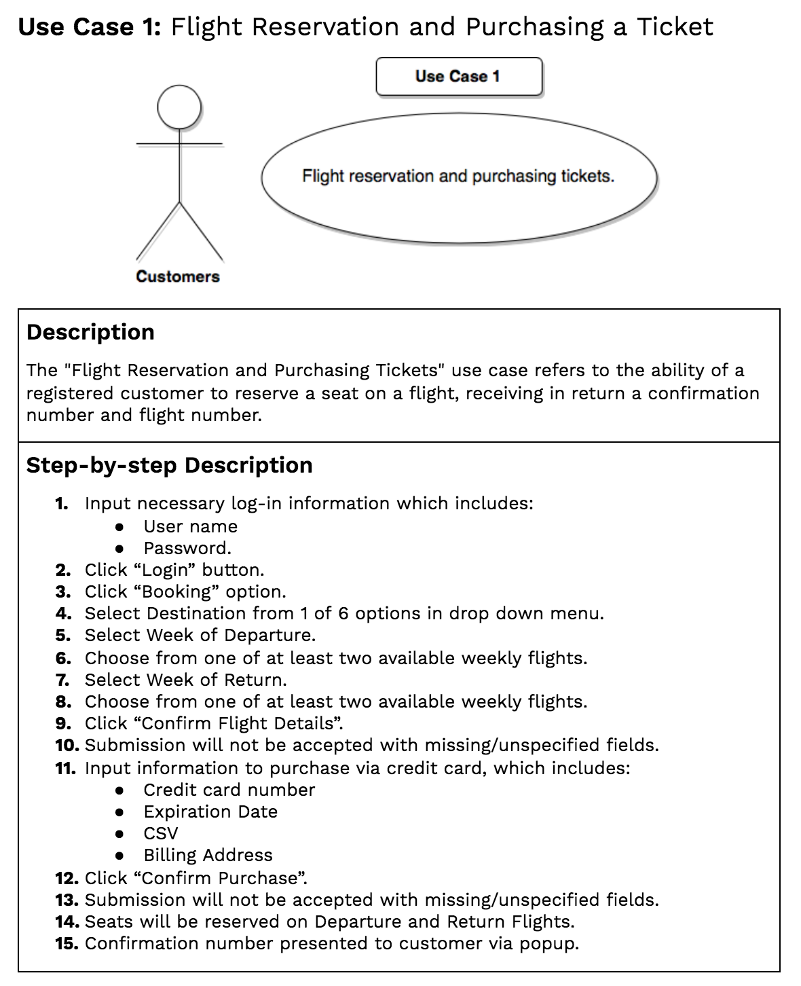
Use Cases
Notes:
Robert

Slide 6
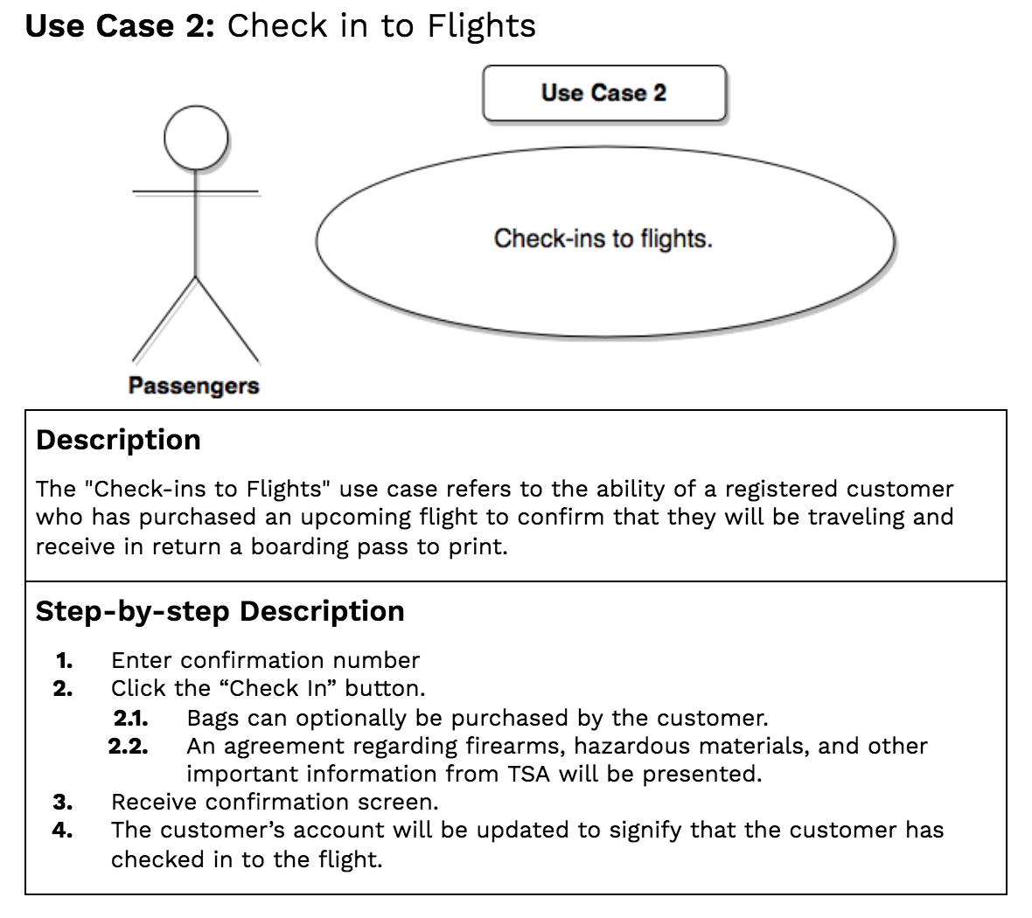
Use Cases

Slide 7
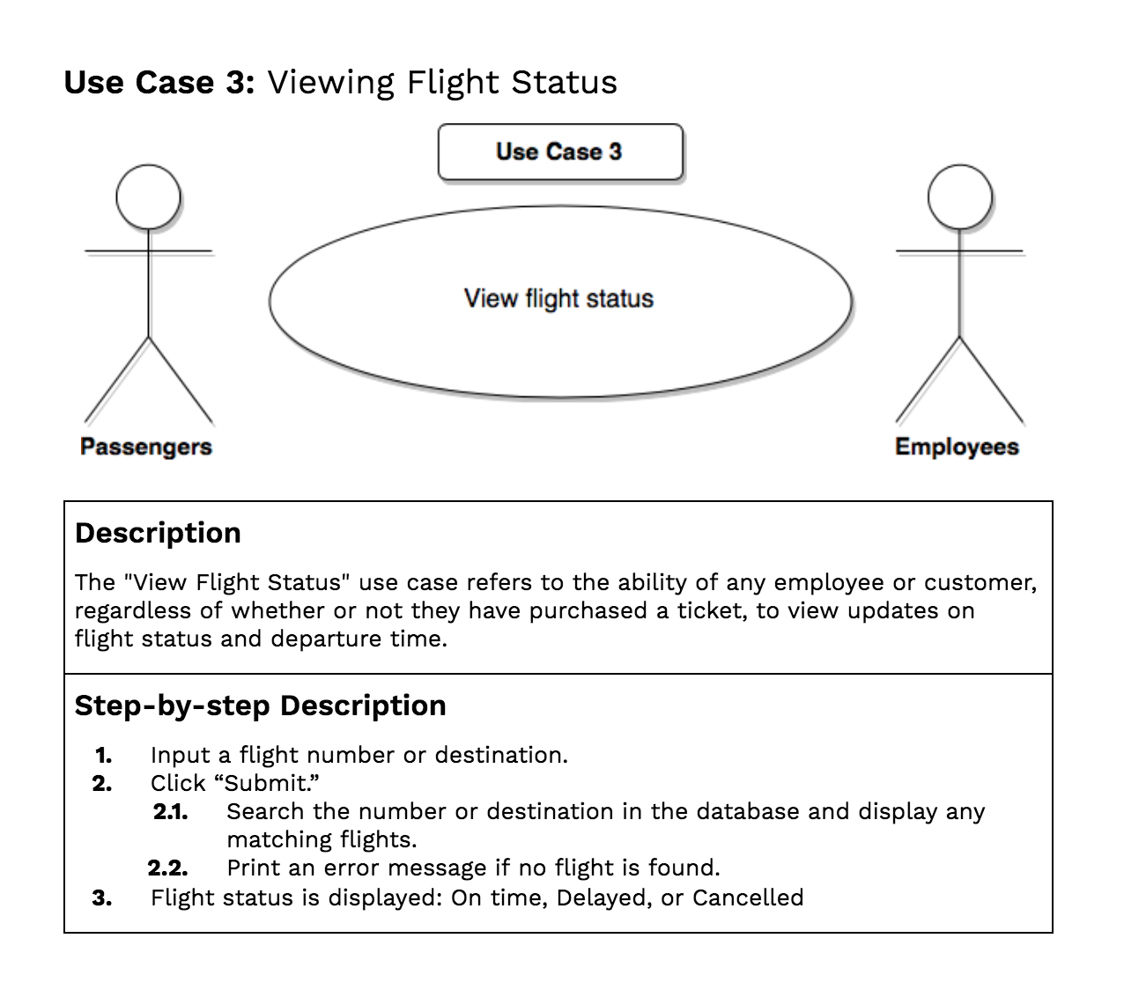
Use Cases

Slide 8
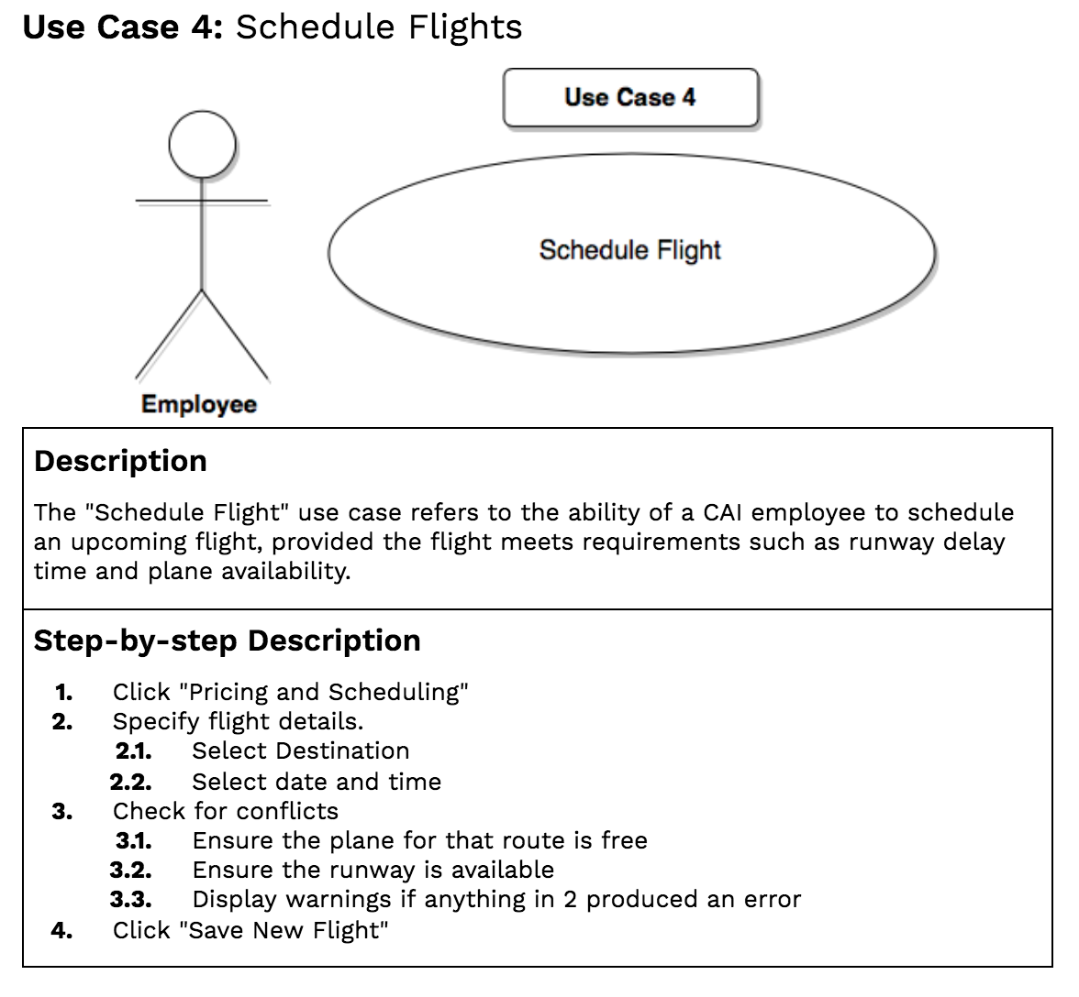
Use Cases

Slide 9
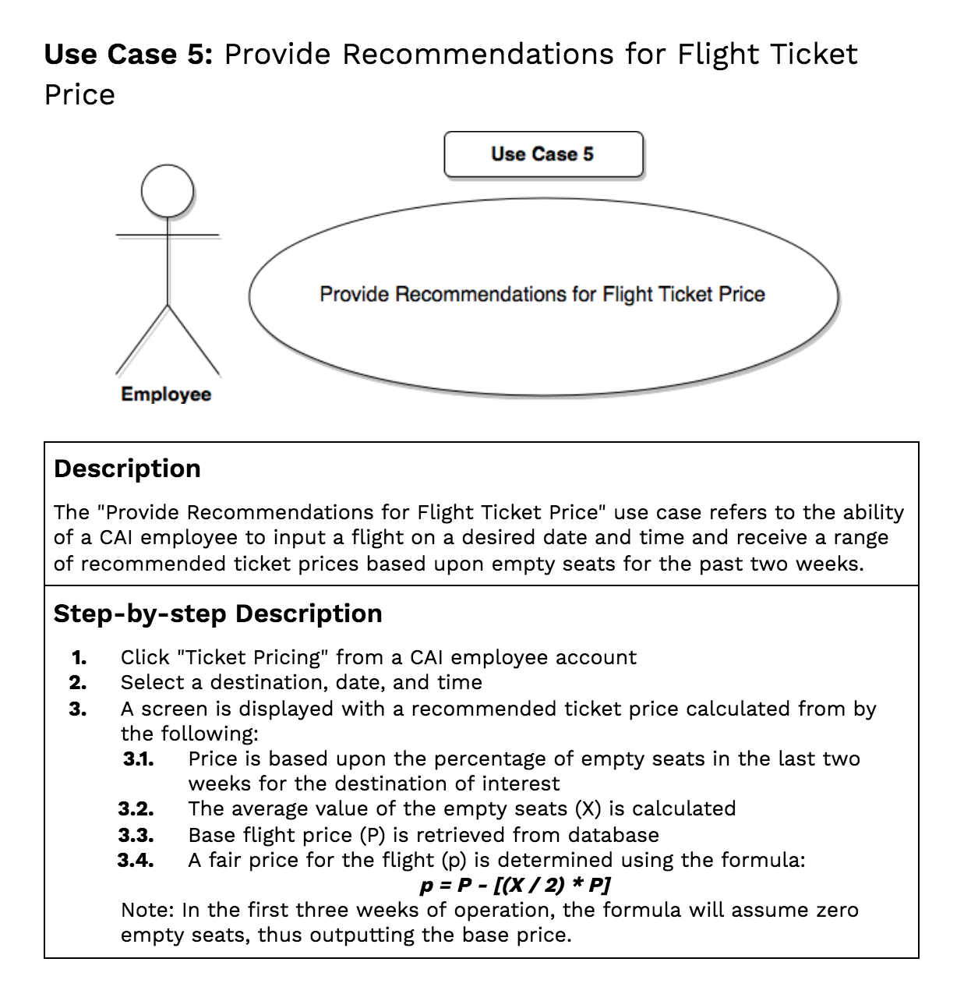
Use Cases

Slide 10
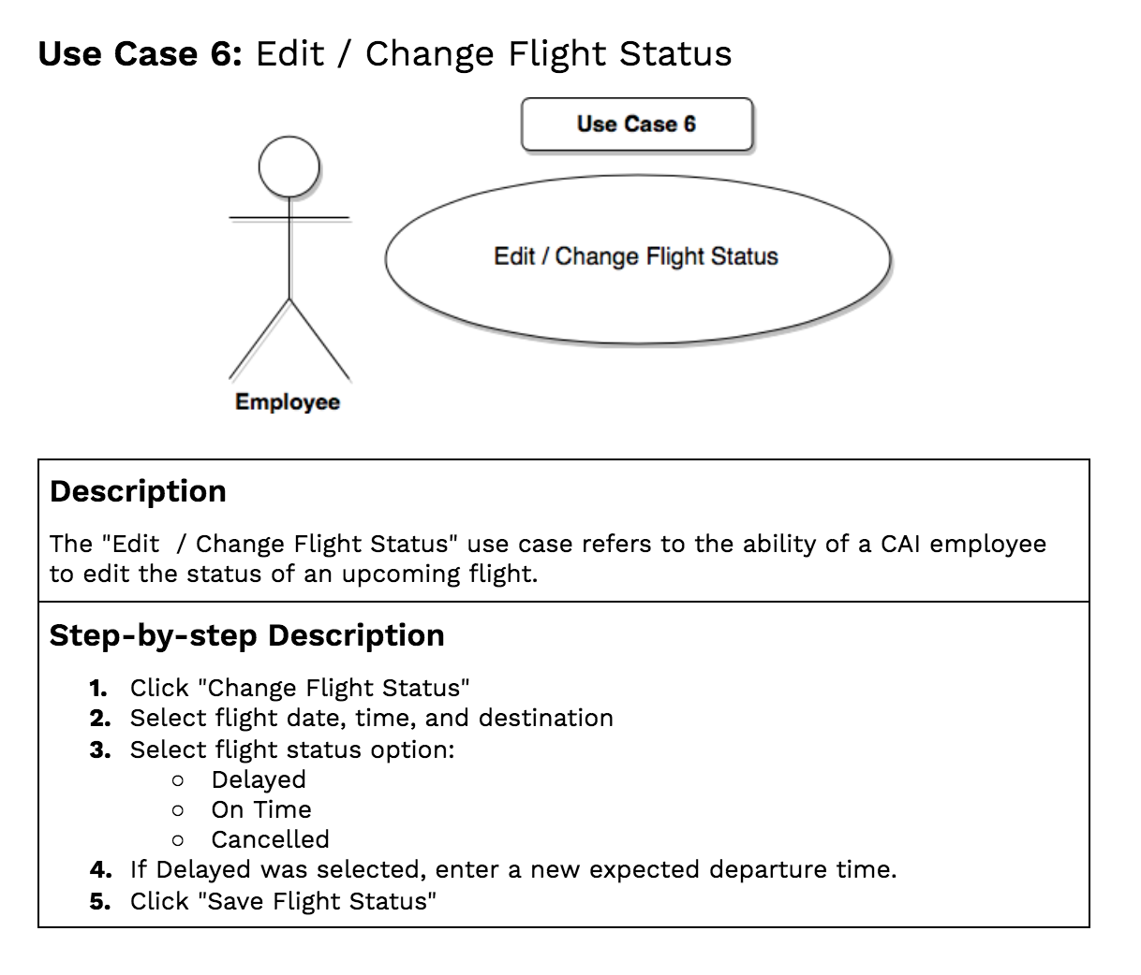
Use Cases

Slide 11
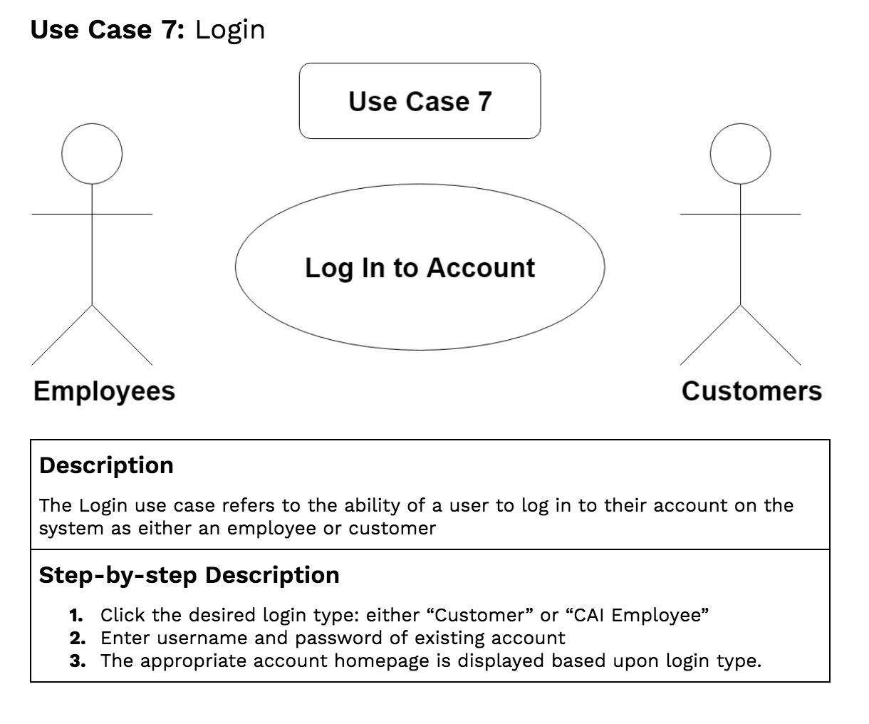
Use Cases

Slide 12
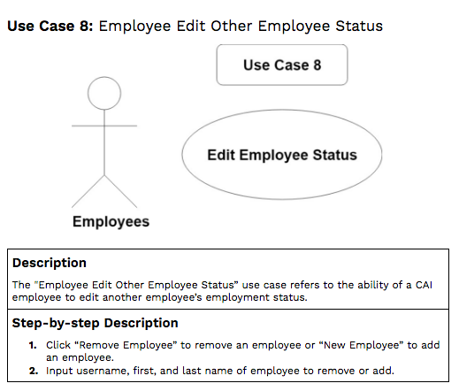
Use Cases

Slide 13
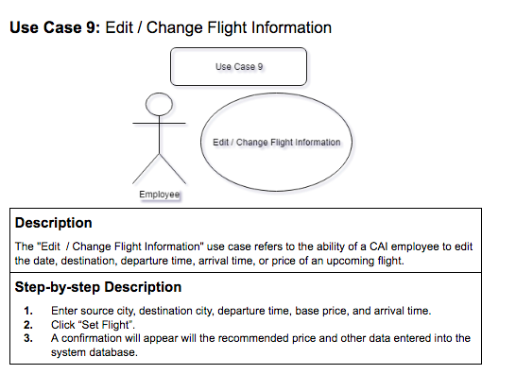
Use Cases

Slide 14
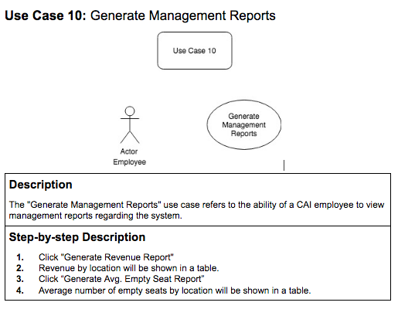
Use Cases

Slide 15
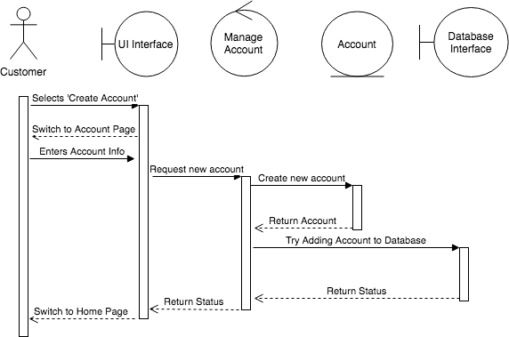
Sequence Diagram
Notes:
Isabel
For use case create customer account

Slide 16
MVC
Model: handles all database and business logic
Controller: control classes for each view allow for communication with the model
View: JavaFX using JFoenix UI Elements with custom CSS
Notes:
Derek
The model used in this system is a class called SQL_Database, which was a class extending an interface Database. This class interfaces with a Sqlite database to store flight, customer, and employee information. Methods are implemented within this class to get information from and store information to the database, as needed.
The controllers correspond to each view of the system. For example, there is a CustomerMainViewController to be an interface between the model (SQL_Database) and the customer view.
The views use JavaFX to interface with the user, providing prompts, accepting input, and outputting information as needed. The views interface with the corresponding controllers through methods called upon a button press and input field variables.

Slide 17
Design Patterns
Singleton for Database
Singleton for customer, employee control
Factory pattern for populating tables
MVC to decouple models, views, and controllers
Notes:
Nick
A singleton pattern was used for the database, customer controller, and employee control ler classes to ensure that all sections of the code refer to the same database connection. This was implemented with a getInstance() function and making the constructor private for the database interface class (SQL_Database).
Additionally, the factory design pattern was used in the employee and customer controllers for populating cells in the flight search table.

Slide 18
Object Oriented Design Principles
Encapsulation: private variables, classes for code that will change, database in SQL_Database class
Abstraction: SQL_Database and text database implemented database interface
Single Responsibility: controller and view classes
Notes:
Isabel
Encapsulation was used by making variables and methods only used within the scope of their class private. Additionally, parts of the program that change frequently were encapuslated within a single class. For example, the database, which changes frequently, was encapsulated within the SQL_Database class.
Abstraction was used by making SQL_Database and a text database (used in the early stages of the project) implement the same interface. This way, a Database object could be created and the same methods would work regardless of the type of database used. This abstraction simplified the process of moving from a text to SQL database since many of the method calls could be used unmodified.
Single Responsibility was used for many of the controller classes, which only implemented a single functionality, such as login. Likewise, single responsibility was also used for many of the view classes.

Slide 19
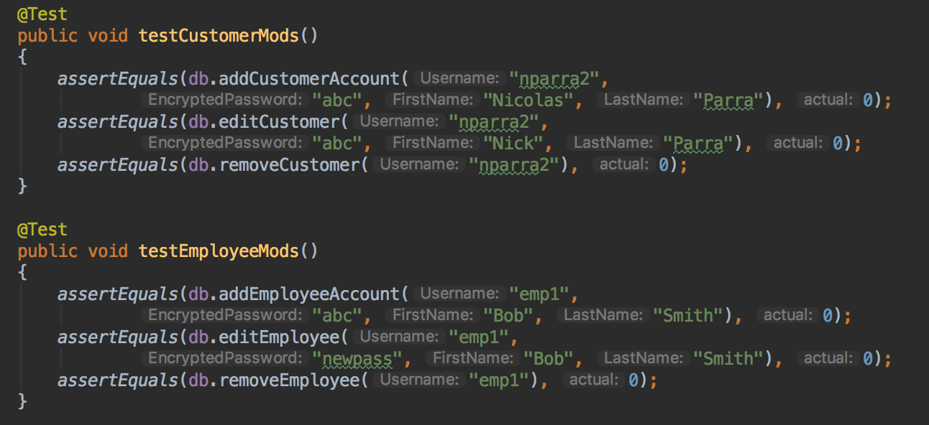
Unit Test Example
Notes:
Marina

Slide 20
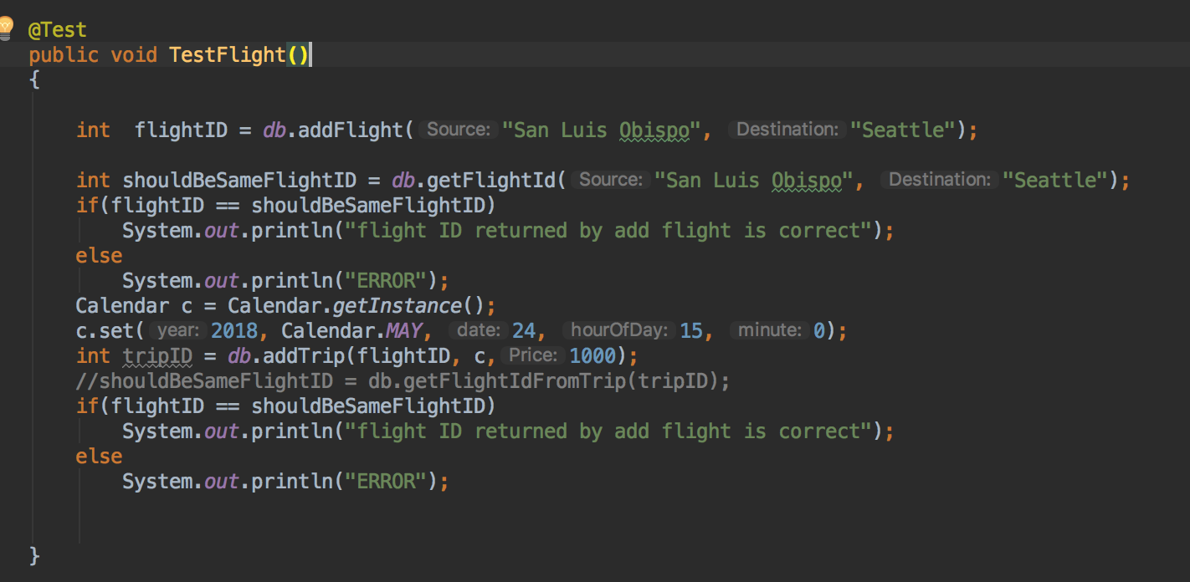
Integration Test Example

Slide 21
Database Design
customers
Username (unique) String -- primary key
EncryptedPassword String
FirstName String
LastName String
employees
Username (unique) String -- primary key
EncryptedPassword String
FirstName String
LastName String
flights
FlightId Int -- primary key
Source String
Destination String
trips
TripId int -- primary key
FlightId int -- (FlightId, Date) is unique
Date (DATETIME type)
Price double
Status int
tickets
Username String
TripId int -- (TripId, SeatNumber) primary key
SeatNumber int
NumBags int
CheckedIn boolean
Notes:
Nick
Also views:
Avg revenue per destination
Number of trips per destination
Number of empty seats per trip

Slide 22
Demo
Notes:
Login to system (As employee)
2. Generate the report to see what are the flights for this week and how many seats are empty
for each flight
3. Change the status of a flight
4. Present A list of businesses rules for flight scheduling
5. Use the flight schedule module to schedule the flights for the next week
6. Use the price recommendation module to calculate the ticket price for the generated flights.
7. Generate the two reports that you have prepared for your system.
8. Login to system (As customer)
9. Present the search flight and purchase ticket by customer
1. Flights generated by flight schedule module should be available to customer with their
associated price
10. Customer should be able to use the confirmation number to check in
11. Present the baggage policy
12. Check the flight status by customer.
1. Use the same flight that it’s status has been changed by employee
13. Log out

Slide 23
Questions?

